Slide 1
Microcontroller Based System Design
CSE 3216
LAB 5

Slide 2
Today’s Contents:
TEMPERATURE SENSOR
DC MOTOR
LDR SENSOR

Slide 3
Temperature Sensor

Slide 4
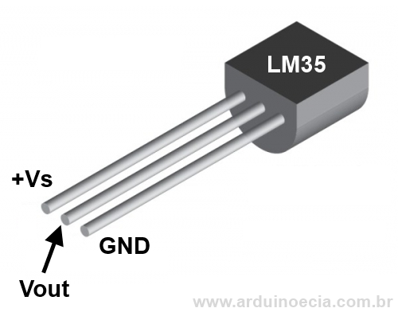
TEMPERATURE SENSOR (LM-35)

Slide 5
TEMPERATURE SENSOR (LM-35)
3 pins: positive voltage(+Vs), ground(GND) and output voltage(Vout)
Output voltage is linearly proportional to the Celsius (Centigrade) temperature
−55˚ to +150˚C temperature range
+ 10.0 mV per 1˚C scale factor

Slide 6
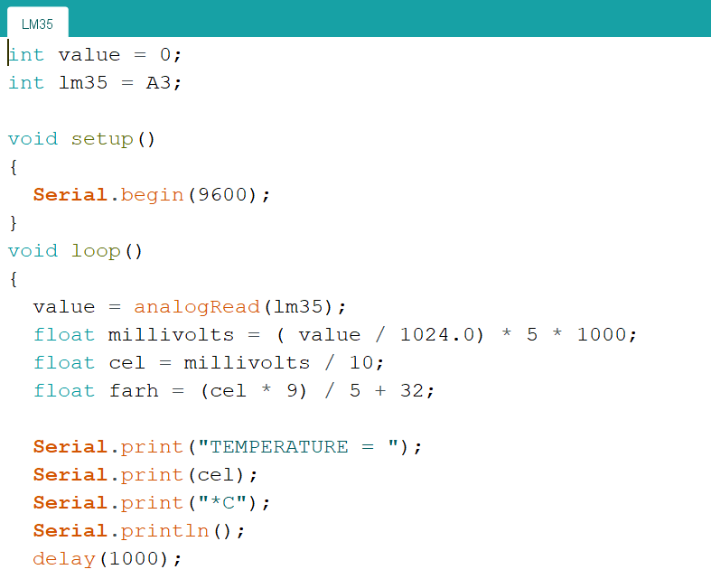
TEMPERATURE SENSOR (LM-35)
Arduino Uno/Mega uses 10-bit analog-to-digital converter
Arduino maps input voltages between 0 and the operating voltage(5V, in case of Uno/Mega) into integer values between 0 to 1023
analogRead()-> gives integer value within 0-1023
To get back the value in volt, we must divide the value by 1024 and multiply it by 5
Scale factor: + 10.0 mV => 1˚C

Slide 7
DC Motor

Slide 8
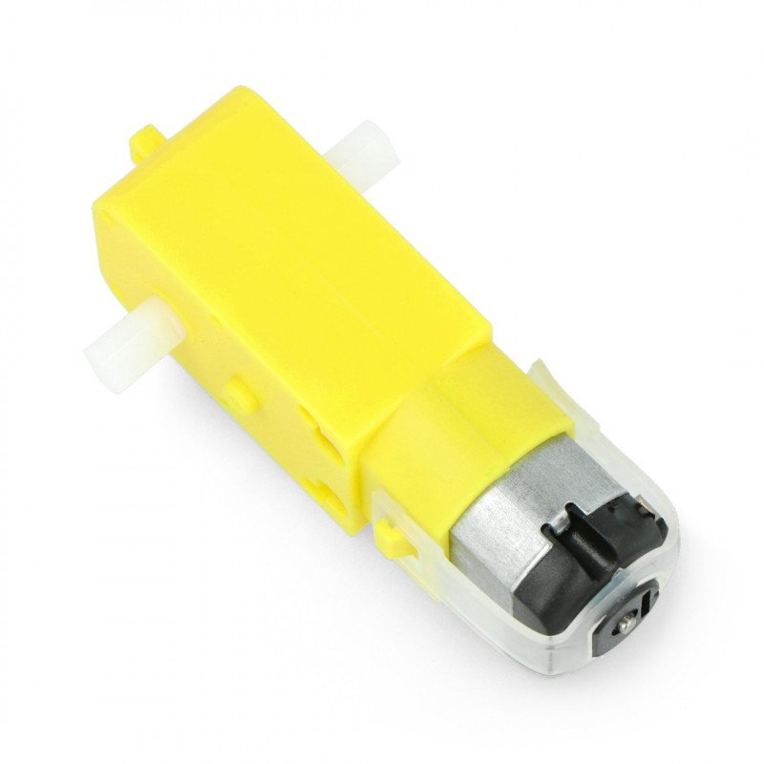
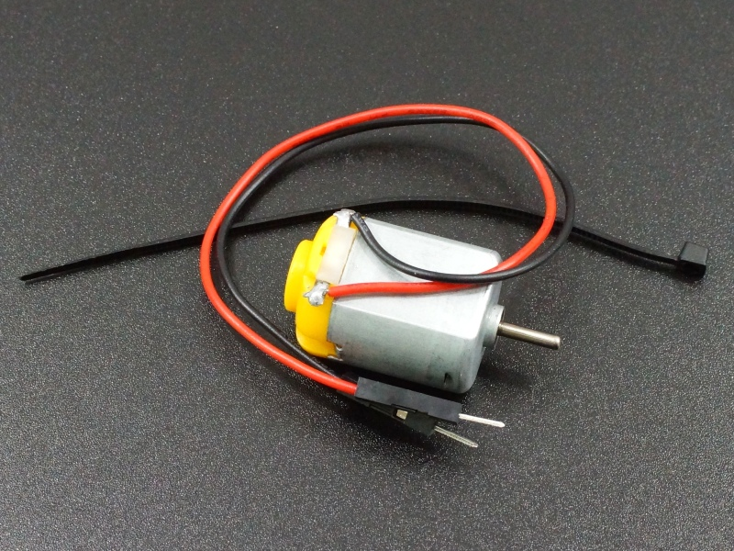
DC Motor

Slide 9
DC Motor(contd)
A direct current (DC) motor is a type of electric machine that converts electrical energy into mechanical energy. DC motors take electrical power through direct current, and convert this energy into mechanical rotation.
DC motors use magnetic fields that occur from the electrical currents generated, which powers the movement of a rotor fixed within the output shaft. The output torque and speed depends upon both the electrical input and the design of the motor.

Slide 10
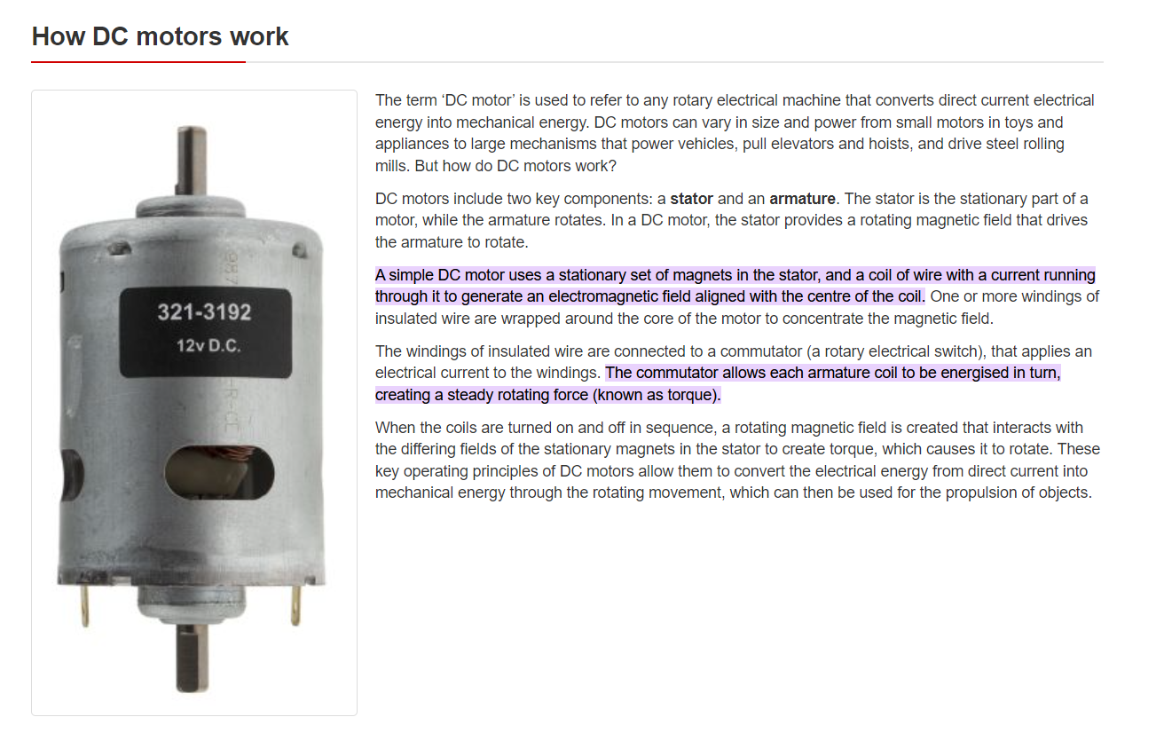
How DC motors work
Reference: https://ie.rs-online.com/web/generalDisplay.html?id=ideas-and-advice/dc-motors-guide#:~:text=A%20simple%20DC%20motor%20uses,the%20centre%20of%20the%20coil.&text=The%20commutator%20allows%20each%20armature,force%20(known%20as%20torque).

Slide 11
Types of DC Motors
Brushed DC Motor:-
The brushed DC motor is the original DC motor. Brushed DC motors utilise soft contacts known as ‘brushes’ to ensure the motor rotates in one direction. Brushed motors’ speed can be varied by the operating voltage or the strength of the magnetic field.
The ‘brushes’ wear down over time. A brushless DC motor is therefore more durable, and also safer than the more classical design.
Brushless DC Motor:-
The key differences between brushless DC motors and other varieties is that they do not have a commutator, which is replaced by an electronic servomechanism that is able to detect and adjust the angle of the rotor.

Slide 12
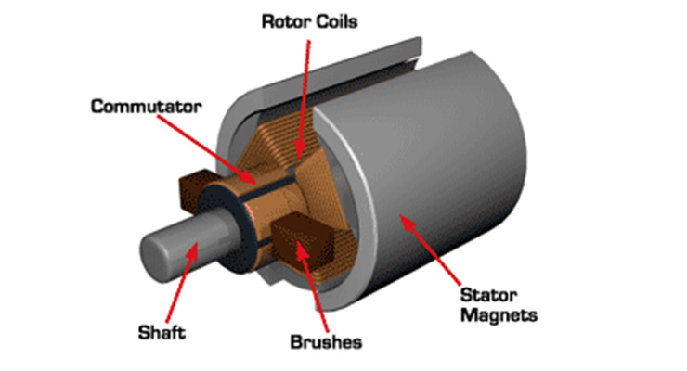
Structure of a DC motor

Slide 13
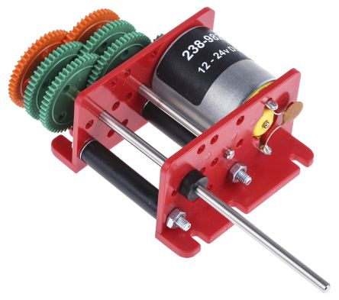
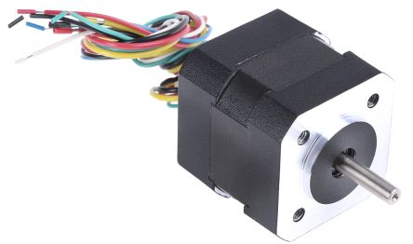
Types of DC Motors(contd)
Brushed DC Motor:-
Brushless DC Motor:-

Slide 14
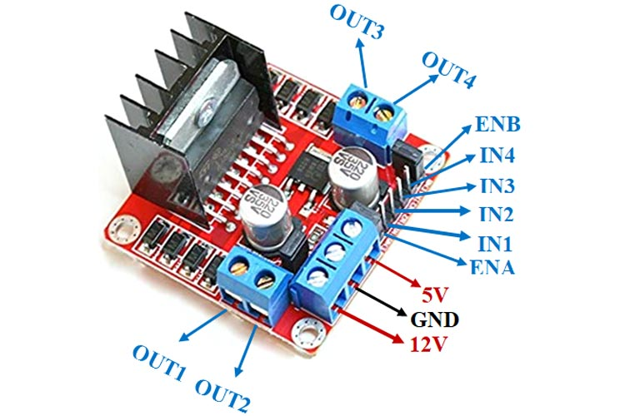
Motor Driver Module(L298N)

Slide 15
Motor Drivers(contd)
Motor drivers acts as an interface between the motors and the control circuits. Motors require high amount of current whereas the controller circuit works on low current signals. So the function of motor drivers is to take a low-current control signal and then turn it into a higher-current signal that can drive a motor.
We should not drive the motor directly from Arduino board pins. This may damage the board.
Reference: https://sproboticworks.com/blog/choosing-the-right-motor-driver#:~:text=Motor%20drivers%20acts%20as%20an,that%20can%20drive%20a%20motor.

Slide 16
Extra Materials
If you want to see the hardware version of DC motor+Arduino connection-
https://www.youtube.com/watch?v=Ey4xoG970Go&ab_channel=educ8s.tv
Working principle of DC motors-
https://www.youtube.com/watch?v=LAtPHANEfQo&ab_channel=Lesics

Slide 17
LDR (Light Dependent Resistor)

Slide 18
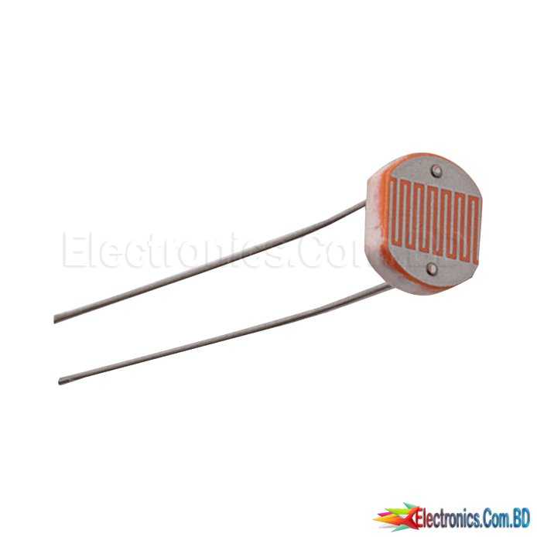
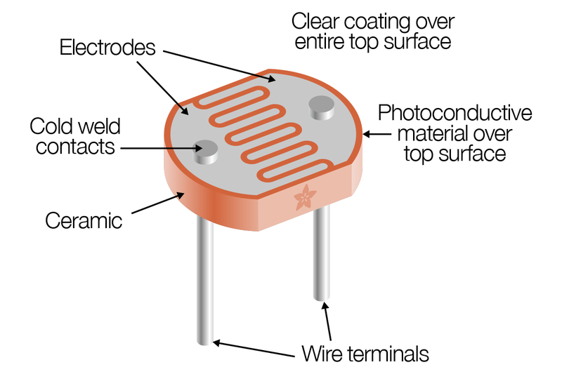
LDR Sensor

Slide 19
LDR
An LDR is a component that has a (variable) resistance that changes with the light intensity that falls upon it. This allows them to be used in light sensing circuits.
Light Dependent Resistors (LDR) are also called photoresistors. They are made of high resistance semiconductor material.
The resistance values of LDR in darkness are several megaohms whereas in bright light it will be dropped to hundred ohms.
More light=>less resistance
Less light=>more resistance

Slide 20
THE END

